Slide 1
Traveling Salesman Problem
Presented By: Abdelilah Bajjou And Oussama Ghaouti

Slide 2
Table of contents
01
02
03
04
05
06
Introduction
Problem Statement
Live Demo
Algorithms Explored
Conclusion
Results and Comparisons

Slide 3
01
Introduction

Slide 4

What is the Traveling Salesman Problem (TSP)?
The traveling salesman problem (TSP) is a programming optimization problem to find the shortest path that connects a given set of points. Finding an exact solution requires a lot of computer power, so various methods of finding approximate solutions are used.
Definition adapted from Gavin Wright, TechTarget

Slide 5
02
Problem Statement

Slide 6
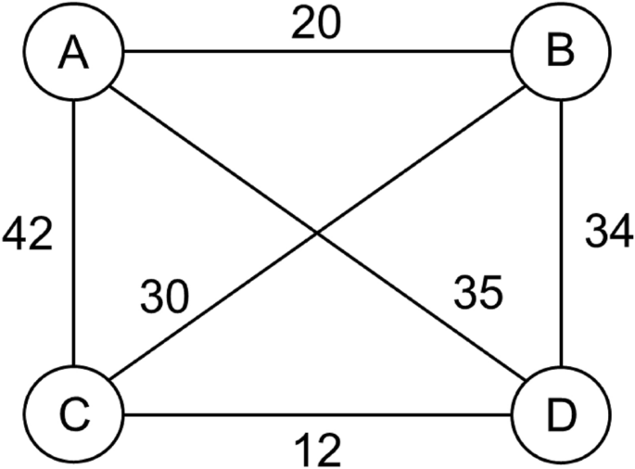
Objective
Minimize the total travel distance by visiting each city exactly once
Constraints
Each city must be visited once and only once

Slide 7
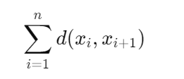
Mathematical Formulation
Minimize:
where xi represents a city, and d(xi,xi+1) is the distance between cities xi and xi+1​. For a tour, the path should return to the starting city, so xn+1=x1​.

Slide 8
03
Algorithms Explored

Slide 9
Algorithmic Approaches
Exact Methods
Approximation Algorithms
-Brute Force Algorithm *
-Branch And Bound *
-Dynamic Programming
(Held-Karp)
-Integer Linear Programming
-Nearest Neighbor Algorithm (Greedy) *
-Christofides Algorithm
-2-opt and 3-opt Heuristics
-Minimum Spanning Tree Approach
Metaheuristic Approaches .
-Genetic Algorithms.
Simulated Annealing
-Ant Colony Optimization
-Tabu Search

Slide 10
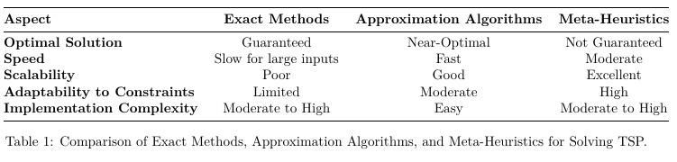
Differences Between TSP Techniques

Slide 11
Why TSP is Challenging: Understanding NP-Hard Complexity
What is NP-Hard?
Problems for which no polynomial-time algorithm is known.
TSP is NP-Hard, meaning solving it exactly is computationally expensive.
Why is TSP Complex?
The number of possible tours grows factorially: n!.
For 10 cities: 10! = 3,628,800 possible tours!
For 15 cities: 15! = 1,307,674,368,000 possible tours. This is more than the number of seconds in over 41,000 years!
Real-World Impact:
TSP arises in delivery routing, logistics, and network optimization.
Solving TSP efficiently can save time and costs.

Slide 12
Brute Force
Description
Enumerates all possible tours and selects the one with the shortest total distance.
Strengths
Weaknesses
Guarantees the optimal solution.
Computationally expensive and infeasible for large datasets (O(n!)).

Slide 13
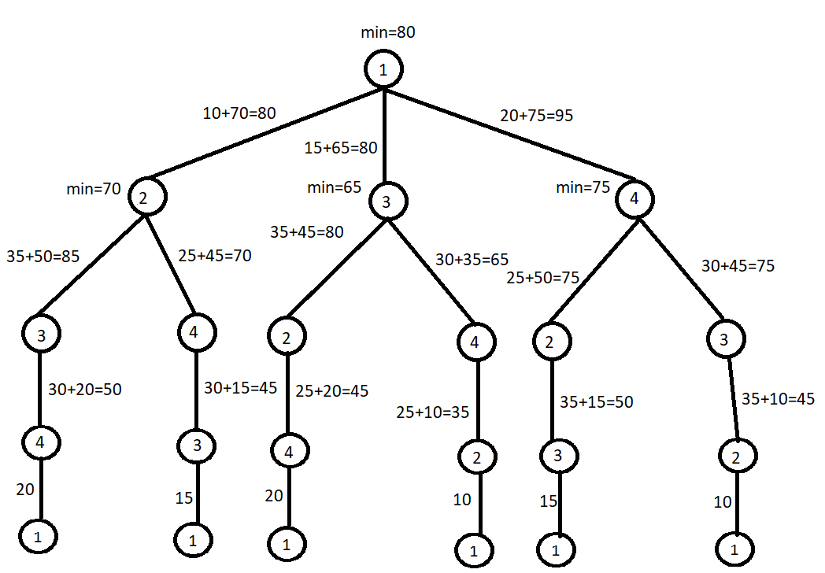
Structure:
It is a decision tree that enumerates all possible paths for visiting the nodes (cities).
Each branch represents a choice for the next city to visit, and all combinations are explored.
Process:
Starting from the root node (city 1), the algorithm explores every possible route by branching out to all other cities.
The total cost (distance) for each route is calculated by summing the distances along the path.
After all paths are computed, the minimum cost (shortest path) is identified.

Slide 14
Branch and Bound:
Description
Systematically explores decision tree branches, pruning branches that exceed current best solutions.
Strengths
Weaknesses
Efficient for solving small-to-medium size problems; guarantees the optimal solution.
Can become computationally expensive for very large problems.

Slide 15
Steps
Step 1: select the starting node
Step 2: Reduce cost matrix to establish lower bound for our current node
Step 3: Expand the current node
Step 4:Compute lower for all feasible routes at current tree depth
Step 5: Repeat Step 1-4 until we meet the maximum depth of our tree

Slide 16
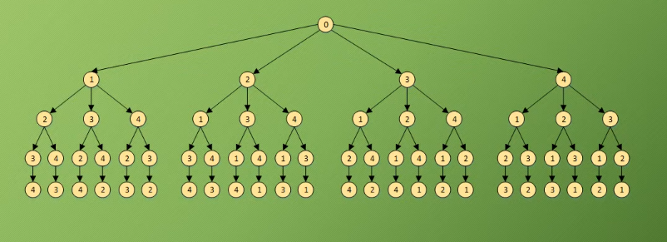

Slide 17
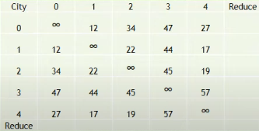
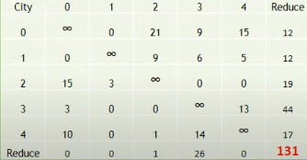
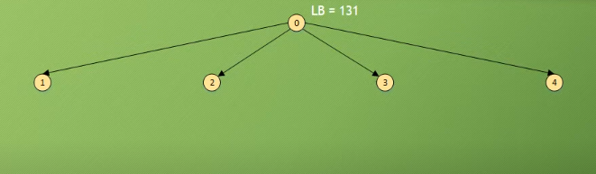
Path (0)
Graph Cost Matrix: Initial State
Graph Cost Matrix Reduced

Slide 18
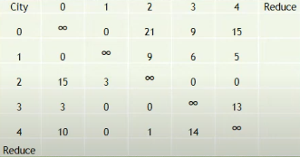
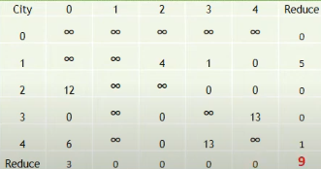
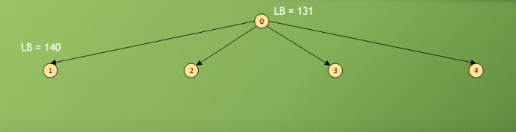
Path (0-1)
Reduced Matrix of Path (0)
Reduced Matrix of Path (0-1)

Slide 19
Path (0-1)
How to calculate the lower Bound ?
Example:calculating the LB in the current Path (0-1):
LB= C(0,1) + LB + new reduction
LB= 0 + 131 + 9 = 140

Slide 20
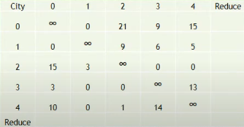
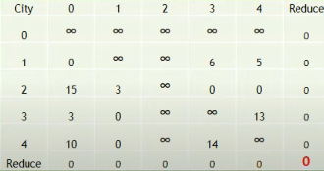
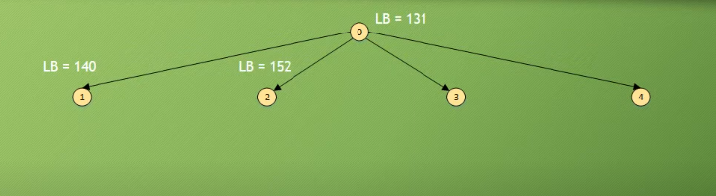
Path (0-2)
Reduced Matrix of Path (0)
Reduced Matrix of Path (0-2)
LB= C(0-2) + LB + new reduction = 21 + 131 + 0 =152

Slide 21
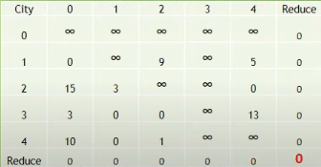
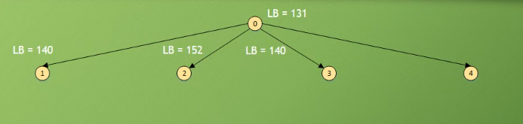
Path (0-3)
Reduced Matrix of Path (0)
Reduced Matrix of Path (0-3)
LB= C(0-3) + LB + new reduction = 9 + 131 + 0 =140

Slide 22
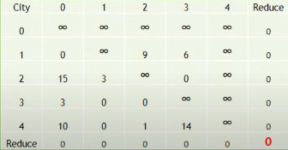
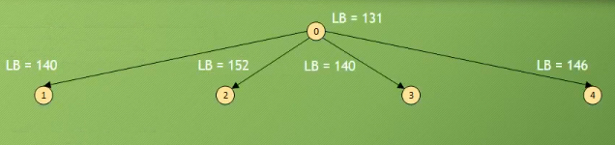
Path (0-4)
Reduced Matrix of Path (0)
Reduced Matrix of Path (0-4)
LB= C(0-4) + LB + new reduction = 15 + 131 + 0 =146

Slide 23
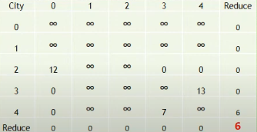
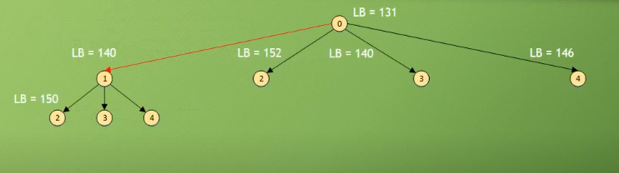
Path (0-1-2)
Reduced Matrix of Path (0-1)
Reduced Matrix of Path (0-1-2)
LB= C(1,2) + LB + new reduction = 4 + 140 + 6 =150

Slide 24
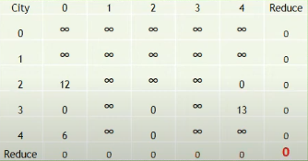
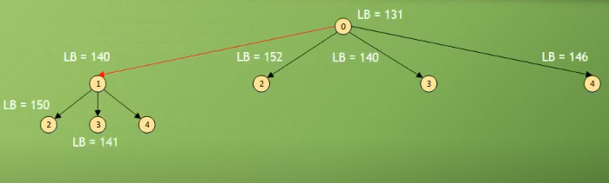
Path (0-1-3)
Reduced Matrix of Path (0-1)
Reduced Matrix of Path (0-1-3)
LB= C(1,3) + LB + new reduction = 1 + 140 + 0 =141

Slide 25
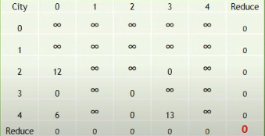
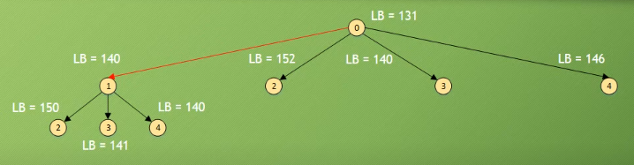
Path (0-1-4)
Reduced Matrix of Path (0-1)
Reduced Matrix of Path (0-1-4)
LB= C(1,4) + LB + new reduction = 0 + 140 + 0 =141

Slide 26
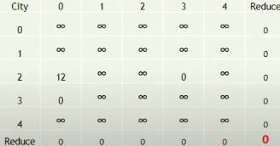
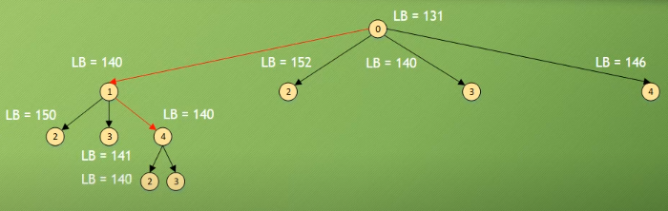
Path (0-1-4-2)
Reduced Matrix of Path (0-1-4)
Reduced Matrix of Path (0-1-4-2)
LB= C(4,2) + LB + new reduction = 0 + 140 + 0 =140

Slide 27
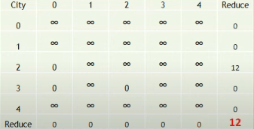
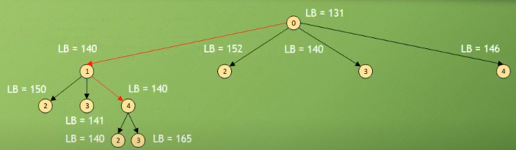
Path (0-1-4-3)
Reduced Matrix of Path (0-1-4)
Reduced Matrix of Path (0-1-4-3)
LB= C(4,3) + LB + new reduction = 13 + 140 + 12 =165

Slide 28
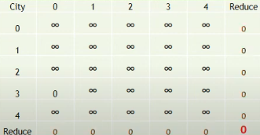
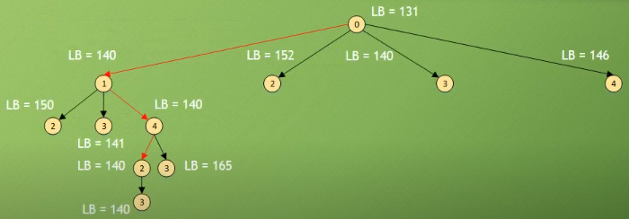
Path (0-1-4-2-3)
Reduced Matrix of Path (0-1-4-2)
Reduced Matrix of Path (0-1-4-2-3)
LB= C(2,3) + LB + new reduction = 0 + 140 + 0 =140

Slide 29
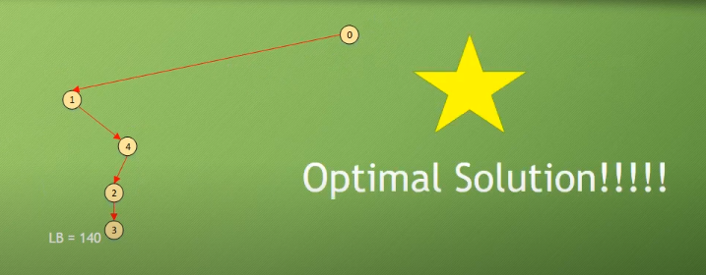

Slide 30
Nearest Neighbor (Greedy Algorithm)
Description
Starts at a random city and always visits the nearest unvisited city until all are visited, then returns to the starting point.
Strengths
Weaknesses
Simple and fast; useful for a quick approximation.
Often produces suboptimal solutions due to lack of global optimization.

Slide 31
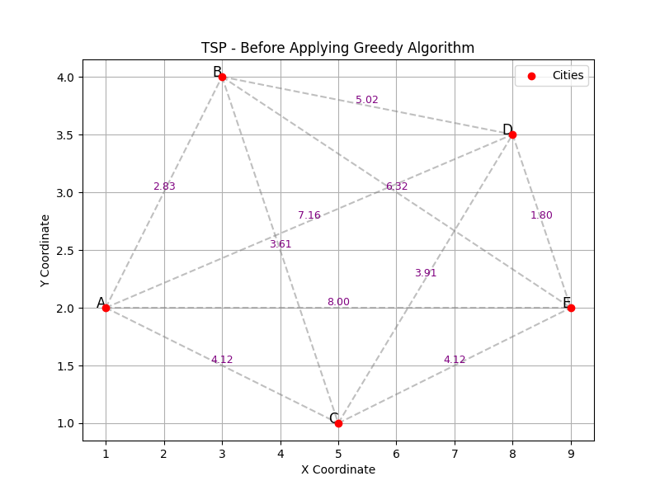

Slide 32
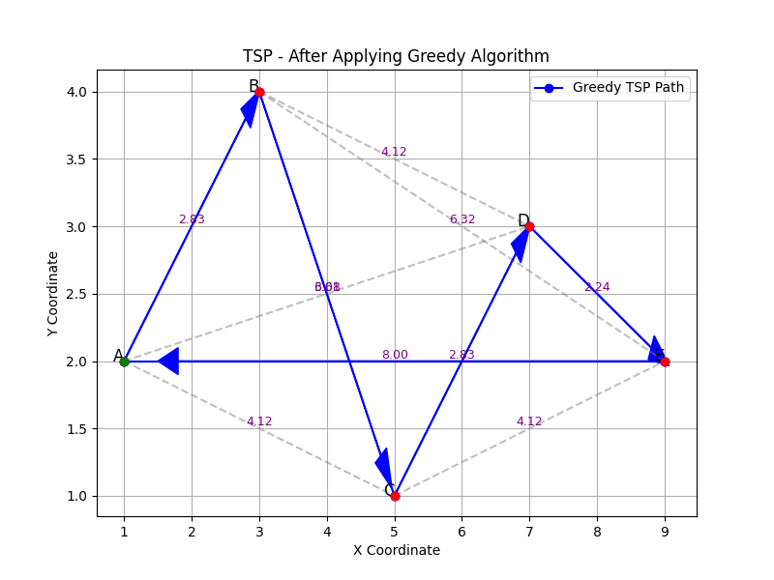

Slide 33
04
Live Demo

Slide 34
05
Results and Comparisons

Slide 35
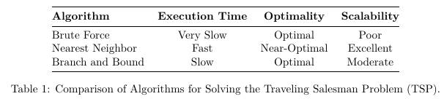
Decoding Efficiency: Which Algorithm Wins the TSP Challenge?

Slide 36
06
Conclusion

Slide 37
The Thrilling Horizon of TSP
Evolving Algorithms: With innovations like AI, hybrid metaheuristics, and quantum computing, the TSP is closer to solving real-world challenges than ever before.
Real-World Impact: From smart logistics to sustainable transport, TSP solutions are transforming industries and driving global progress.
The Road Ahead: Future research promises breakthroughs in handling complexity, scaling big data, and developing interactive tools that make TSP not just a problem to solve, but a gateway to innovation.

Slide 38
Any Questions?

